Slide 1
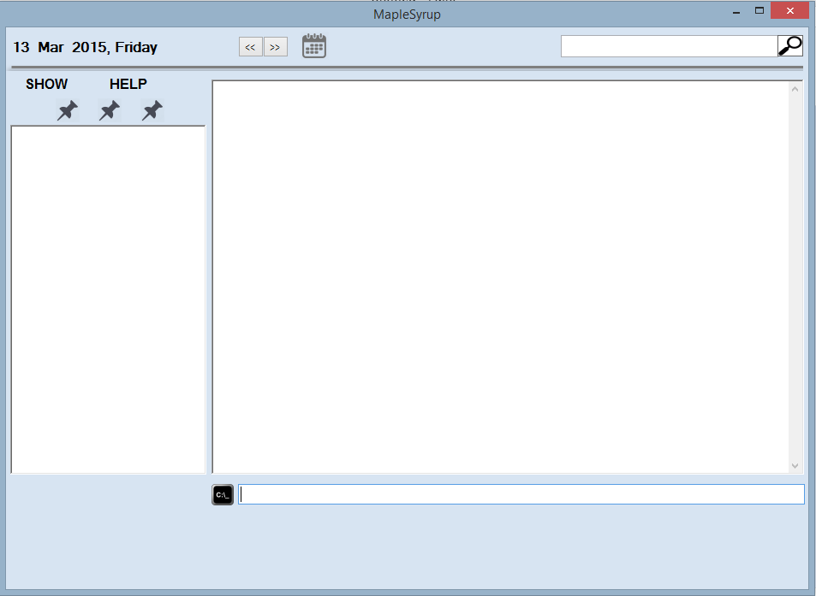
Label of main display
Search Box
Buy Starbucks
Do Homework
Sleep
Calendar display button
Ongoing Tasks Display
Main Display
Welcome to MapleSyrup, Jim.
User-defined
Categories
Command Box
School
Work
Food
Sleep Added
Feedback Box

Slide 2
Start
4. [12:30pm-1.30pm] Lunch with John
5. [2pm-5pm] 2103 Lecture #School
Buy Starbucks
Do Homework
Sleep
Please type in the command box below
School
Work
Food
Notes:
Main display will display the tasks for today;
If no tasks today. It will display the list of commands

Slide 3
Add
4. [12:30pm-1.30pm] Lunch with John
5. [2pm-5pm] 2103 Lecture #School
Buy Starbucks
Do Homework
Sleep
Please type in the command box below
School
Work
Food
add CS2103 finals; 8 april 8am to 1015am
add CS2103 finals; 8 april 8am to 1015am
Notes:
Suggestion Box will appear to show you the correct format of input.

Slide 4
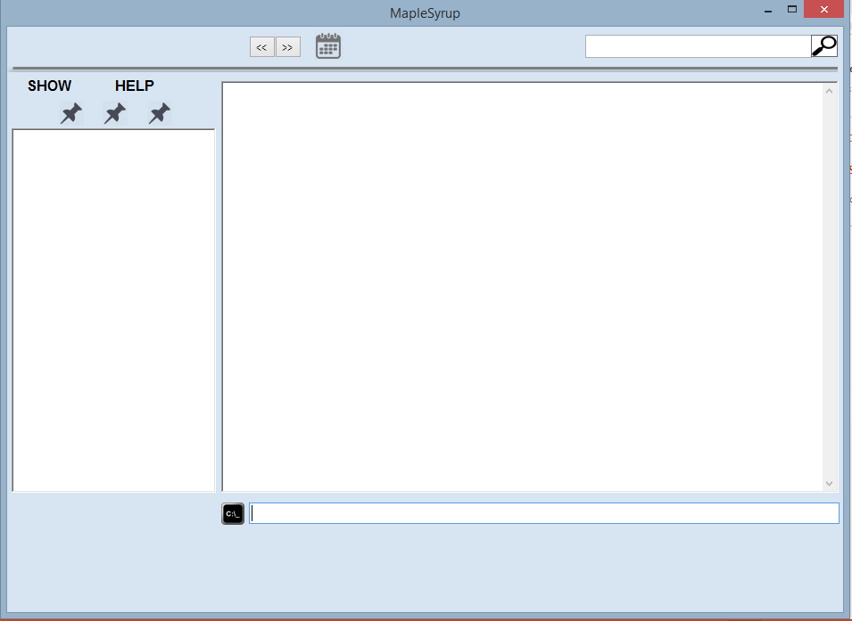
8 April 2015, Wednesday
4. [8am-1015am] CS2103 finals
[12pm-2pm] lunch
[9pm-11pm] party
Buy Starbucks
Do Homework
Sleep
School
Work
Food
CS2103 finals added
Notes:
Newly added event will be in green

Slide 5
8 April 2015, Wednesday
[8am-1015am] CS2103 finals
[12pm-2pm] lunch
[9pm-11pm] party
[10pm-11pm] supper
Buy Starbucks
Do Homework
Sleep
School
Work
Food
CS2103 finals added
Supper added
Notes:
Newly added event that clashed with existing event will be highlighted in red

Slide 6
Delete
4. [12:30pm-1.30pm] Lunch with John
5. [2pm-5pm] 2103 Lecture #School
Buy Starbucks
Do Homework
Sleep
Please type in the command box below
School
Work
Food
delete Do Homework
Delete Homework
Notes:
Suggestion Box will appear to show you the correct format of input.

Slide 7
3. [12:30pm-1.30pm] Lunch with John 4. [2pm-5pm] 2103 Lecture #School
Buy Starbucks
Sleep
Please type in the command box below
School
Work
Food
Homework deleted

Slide 8
Search
School
School
All Day Engin Day
[8am-1015am] CS2103 finals
[3pm-4pm] High tea (Utown green under the trees with my cat
and friends)
Buy Starbucks
Do Homework
Sleep
School
Work
Food
CS2103 finals added
Supper added
School displayed
Notes:
The top left box will show the label of what is being displayed on the main display

Slide 9
Edit
School
All Day Engin Day
[8am-1015am] CS2103 finals
[3pm-4pm] High tea (Utown green under the trees with my cat
and friends)
Buy Starbucks
Do Homework
Sleep
School
Work
Food
edit CS2103 finals; 9am-10am
edit CS2103 finals; 9am-10am
CS2103 finals added
Supper added
School displayed
Notes:
Suggestion Box will appear to show you the correct format of input.

Slide 10
School
All Day Engin Day
[9am-10am] CS2103 finals
[3pm-4pm] High tea (Utown green under the trees with my cat
and friends)
Buy Starbucks
Do Homework
Sleep
School
Work
Food
Supper added
School displayed
CS2103 finals edited

Slide 11
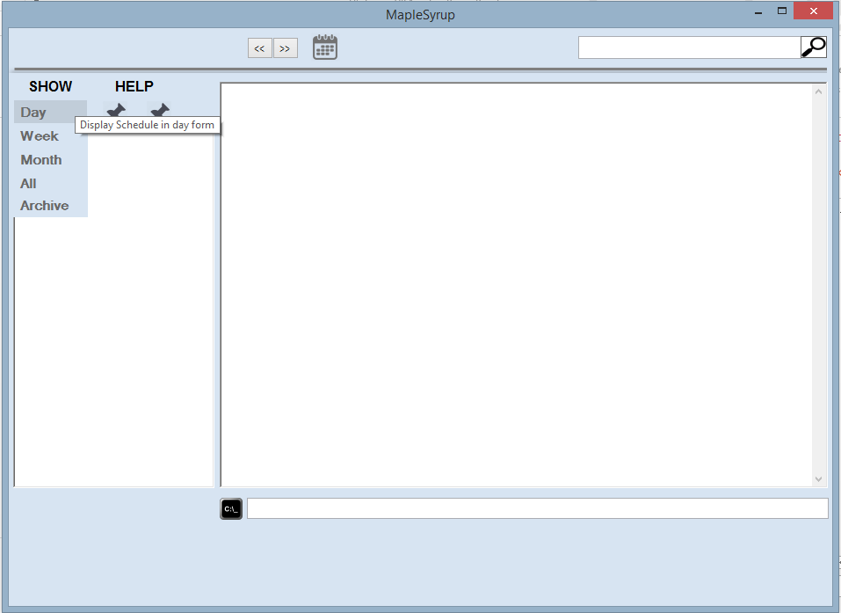
Display event
School
All Day Engin Day
[9am-10am] CS2103 finals
[3pm-4pm] High tea (Utown green under the trees with my cat
and friends)
Starbucks
Homework
School
Work
Food
Supper added
School displayed
CS2103 finals edited
Notes:
Simple move your mouse over to “SHOW” and press on the format you would like to display.
Alternatively, one can type “show day”

Slide 12
4. [12:30pm-1.30pm] Lunch with John
5. [2pm-5pm] 2103 Lecture #School
Buy Starbucks
Do Homework
Sleep
School
Work
Food
School displayed
CS2103 finals edited
Day displayed

Slide 13
Scrolling through displays
4. [12:30pm-1.30pm] Lunch with John
5. [2pm-5pm] 2103 Lecture #School
Buy Starbucks
Do Homework
Sleep
School
Work
Food
School displayed
CS2103 finals edited
Day displayed
Notes:
Press the << or >> buttons at the top of the UI.

Slide 14
14 March 2015, Saturday
4. [12pm-2pm] Lunch with family
[9pm – 11pm] John bday party
Buy Starbucks
Do Homework
Sleep
School
Work
Food
School displayed
CS2103 finals edited
Day displayed
School displayed
CS2103 finals edited
Day displayed

Slide 15
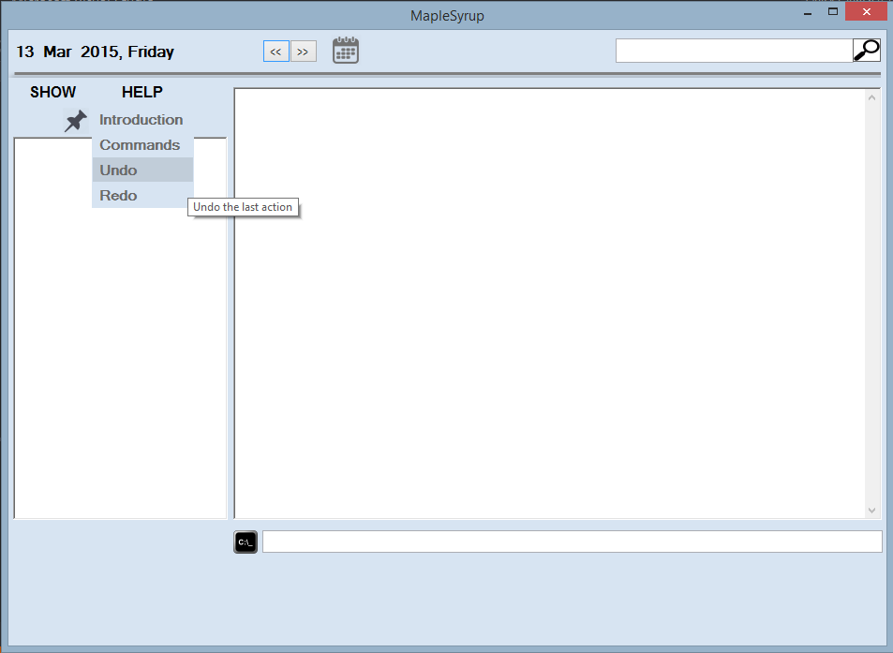
UNDO
All Day Engin Day
[9am-10am] CS2103 finals
[3pm-4pm] High tea (Utown green under the trees with my cat
and friends)
Buy
Do
School
Work
Food
Supper added
School displayed
CS2103 finals edited
Notes:
Simple move your mouse over to “HELP” and press ‘Undo’
Alternatively, you can also type undo on the command bar.

Slide 16
All Day Engin Day
[8am-1015am] CS2103 finals
[3pm-4pm] High tea (Utown green under the trees with my cat
and friends)
Buy Starbucks
Do Homework
School
Work
Food
School displayed
CS2103 finals edited
Undo: CS2103 finals edited

Slide 17
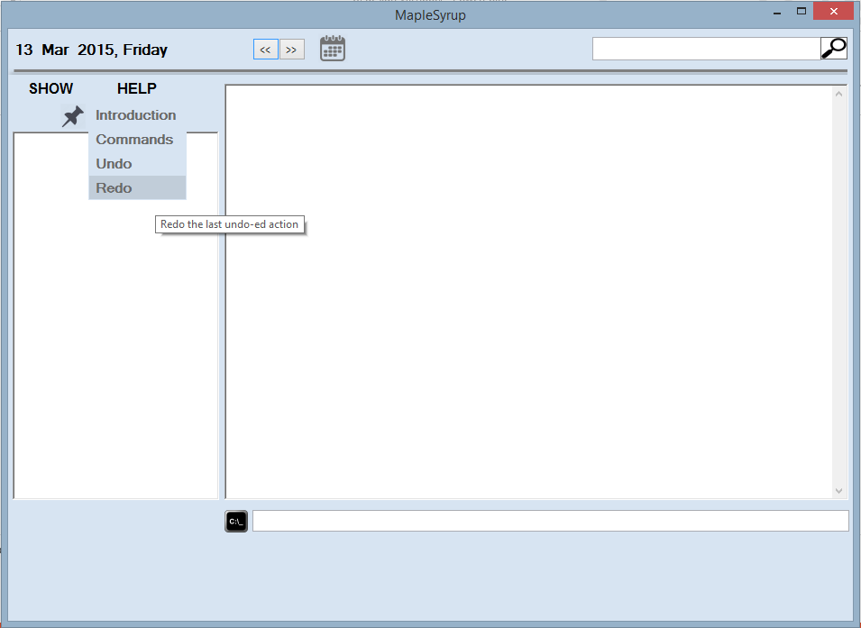
REDO
All Day Engin Day
[8am-1015am] CS2103 finals
[3pm-4pm] High tea (Utown green under the trees with my cat
and friends)
Buy
Do
School
Work
Food
School displayed
CS2103 finals edited
Undo: CS2103 finals edited

Slide 18
All Day Engin Day
[9am-10am] CS2103 finals
[3pm-4pm] High tea (Utown green under the trees with my cat
and friends)
Buy Starbucks
Do Homework
School
Work
Food
CS2103 finals edited
Undo: CS2103 finals edited
Redo: CS2103 finals edited

Slide 19
HELP

